Slide 1
Recruiters and Voting
Recruiting Offices as Voter Registration Agencies

Slide 2
Recruiting Personnel
All personnel assigned to duty at Recruiting Offices for the Armed Forces shall be trained and capable of providing these services or assistance.

Slide 3
Background
52 U.S.C. Ch 205 (NVRA) designates Armed Forces recruiting offices as voter registration agencies
DoD Directive 1344.13 implemented 52 U.S.C. Ch 205 within all Services requiring recruiting offices to:
  Provide prospective enlistees the mail voter registration application and the DD Form 2645
  Assist the citizen in completing the voter registration application
  Transmit the completed voter registration application to the appropriate State office
  Maintain statistical information and records on voter registration assistance
Services to ensure all recruiters are informed and trained in the voter registration assistance duties.

Slide 4
NVRA
National Voter Registration Act (NVRA)
NVRA designates recruiting offices as voter registration agencies.
NVRA defines the assistance recruiting offices must provide for voter registration.
  Must offer to each voting-eligible person who comes into the recruiting office the opportunity to apply for voter registration.
  Includes prospective recruits as well as anyone who enters the office.
  Must assist the citizen in completing the application.
  Must be totally non-partisan and not display any political leaning.
  Must inform citizen that voter registration will not have any effect on joining the military.
  Must mail the completed application to the appropriate state office.
  Must keep and report metrics regarding voter registration assistance

Slide 5
Voting Assistance
Maintain local stock of two forms:
National Mail Voter Registration Form
  Available at https://www.eac.gov/assets/1/6/Federal_Voter_Registration_6-25-14_ENG.pdf.
DD Form 2645, Voter Registration Information (Yes/No) Form
  Available at http://www.dtic.mil/whs/directives/forms/eforms/dd2645.pdf

Slide 6
Voting Assistance
Offer the Voter Registration Information Form (DD Form 2645 - PDF-Ext) to ALL voter eligible persons entering the recruiting office who are U.S. citizens and will be 18 years old by the date of the next federal General election.
Ask ONLY two questions pertaining to voter registration upon applicant walk-in:
  Are you a U.S. citizen?
  Will you be 18 years old by the date of the election.
  DO NOT ask, "Are you a convicted felon"?
NOTE: If an applicant is currently 17 years old but will be 18 by the date of election, they may be assisted with voter registration now.

Slide 7
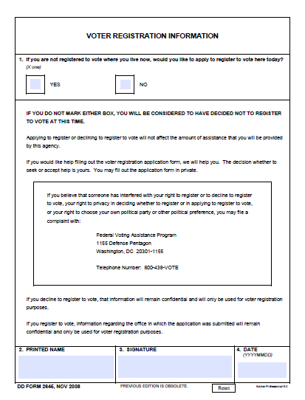
DD Form 2645

Slide 8
DD Form 2645
“Yes” Answers
When the applicant checks "Yes", recruiters will proceed to provide a National Mail Voter Registration Form (NVRF) and Guide.
Applicants will be given the option to take home the completed NVRF or request assistance from the recruiter in completing the NVRF then submit it to the recruiting station via the recruiter.
For completed NVRFs submitted to the recruiting station, the recruiter will affix First Class postage and mail the NVRF to the appropriate state election office no later than:
  10 days from acceptance; OR
  5 days from acceptance if a looming election deadline merits

Slide 9
DD Form 2645
“No” Answers
When the applicant checks "No", recruiters will cease voting registration assistance.
If the date of signature is 18 Dec 11 for example, write "Destroy: 18 Dec 13" in the upper right corner of the completed DD Form 2645.
If an applicant refuses to complete a DD Form 2645, do not be pushy.
Credit ALL walk-in attendance for recruiting services in column 1 of the monthly/quarterly Voting Registration Assistance Metrics report.

Slide 10
Voting Assistance
Provide to any eligible citizen who enters a recruiting office, the same level of voters registration assistance as any prospective recruit/applicant.
Regardless of the applicant's response, "Yes" or "No", on the DD Form 2645, completed forms must be forwarded to the District's Voting Assistance Officer for retention for a minimum of two years.
For further guidance, visit the following websites:
  U.S. Election Assistance Commission: www.eac.gov
  Military Recruiter Information: http://www.fvap.gov/vao/recruiter

Slide 11
How to Do It
Keep Records of:
The number of citizens entering the recruiting office.
The number of citizens provided a DD 2645.
The number of citizens provided the National Mail Voter Registration Form.
The Number of National Mail Voter Registration Forms mailed for the citizen.
  The cost of postage to mail the form.
The number of citizens taking their National Mail Voter Registration Form with them.
Keep the DD 2645s for a period of two years.

Slide 12
How to Do It
Suggestions
Print several copies of the instructions contained in the National Mail Voter Registration Form for citizens to use.
Print multiple copies of the actual form and/or,
Set up a computer where the citizen can complete and print the form.

Slide 13
Voting Metrics Reports
Monthly and quarterly format used to track recruiting station voting assistance data. 6 columns of reporting criteria:
  State: Enter the state for which your data is reported. If your recruiting area covers more than one state, then data must be reported for each state
  Number of Persons Assisted for Recruiting Services: Enter the number of people assisted for recruiting service, to include non-prospect walk-ins seeking application forms or voting information. List everyone regardless of age.
  Completed DD Form 2645 (Yes or No): Enter the number of DD Form 2645 completed regardless of the answer (yes or no)/ Only U.S. citizens 18 years old by the date of election will complete this form.
  Number of Voter Registration Applications Submitted by Recruiting Offices by State.
  Number of Voter Registration Applications Taken by Citizens but not Submitted by Recruiting Offices.
  Total Mailing Costs to Submit Voter Registration Applications to States.

Slide 14
Voting Metrics Submission
Metrics must be submitted using the FVAP.gov portal;
Visit https://www.fvap.gov/portal/login/auth.html and select “Register for an Account” to create your portal account
Once you follow the prompts, you will receive an email to confirm your account registration.
Login to the portal using your username and password.
Click the Metrics tab.
Submit your metrics by the end of each quarter (March 31, June 30, September 30, December 31).
Your service may have additional metrics submission requirements

Slide 15
Stay Nonpartisan
Recruiting personnel must NOT at any time:
Seek to influence an applicant's political preference or party registration.
Display any political preference or party allegiance.
Make any statement to an applicant or take any action in order to discourage the applicant from registering to vote.
Make any statement to an applicant or take any action in order to lead the applicant to believe that a decision to register or not to register has any bearing on the availability of services or benefits.
Use information relating to a declination to register to vote in connection with an application made at your office for any purpose other than voter registration.

Slide 16
Recruiting Personnel
Recruiting personnel and their voting eligible family members may register to vote absentee using the automated assistant at www.fvap.gov.
Once complete, the Federal Post Card Application (SF-76) must be printed and mailed by the service member upon completion (may not be submitted online).
Postage is pre-paid by the federal government for uniformed service members and their voting eligible family members.
National Mail Voter Registration Form for civilians requires first class postage for mailing.

Slide 17
Summary
Recruiters are required by law to provide non-partisan voter registration assistance.
Applies to all citizens who enter the recruiting office.
  Not required during field visits.
Office must print and maintain stocks of the National Mail Voter Registration Form and the DD 2645.
Must collect and maintain statistics for voter registration assistance.
Report voter registration statistics quarterly or as required by the recruiting command.
Must retain DD 2645s for two years.

Slide 18
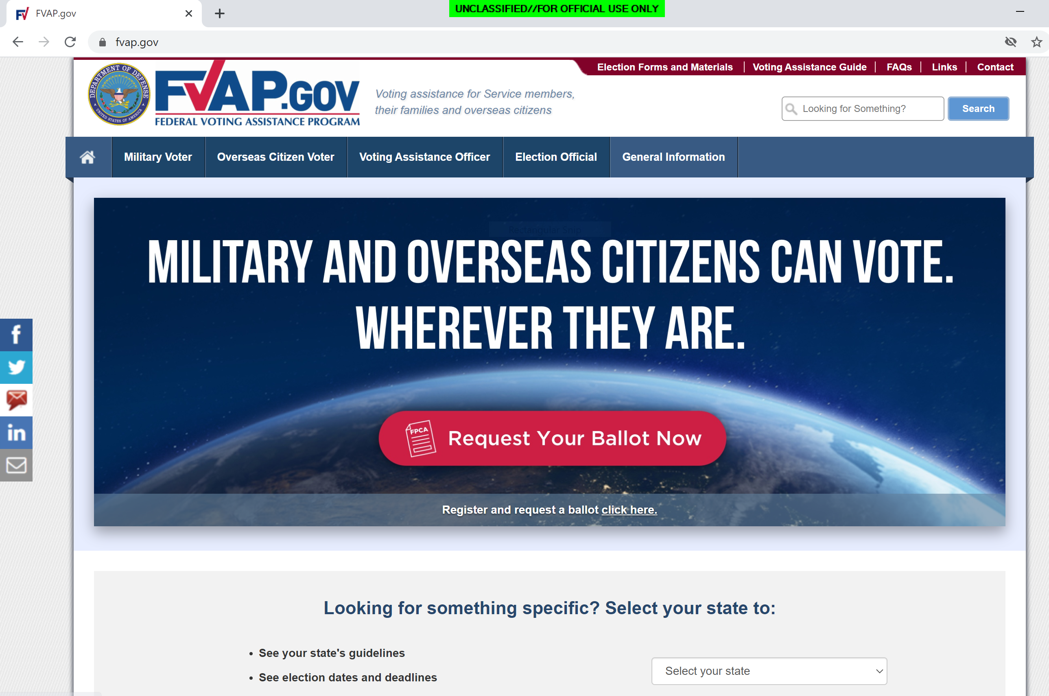
Resources
Access Recruiter Information and Handouts
Access Online Assistants for Registration

Slide 19
Federal Voting Assistance Program
FVAP.gov
vote@fvap.gov
1-800-438-VOTE(8683)
DSN: 425-1584
@FVAP Facebook.com/DoDFVAP

